Slide 1
Introduction to Pattern Recognition
Chapter 01
Ref. Book: Pattern Classification - R. Duda et al.
Rakib Mahmud
Lecturer, BUBT

Slide 2
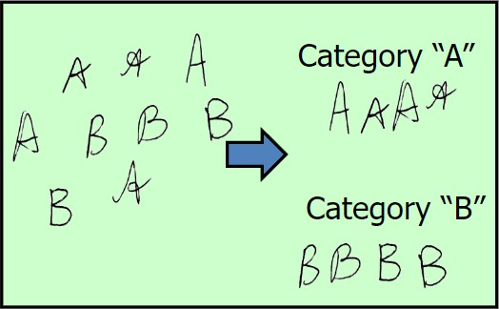
Pattern Recognition/Classification
Assign an object or an event (pattern) to one of several known categories (or classes).

Slide 3
What is Pattern
A set of instances that
share some regularities and similarities
is repeatable
is observable, sometimes partially, using sensors
may have noise and distortion

Slide 4
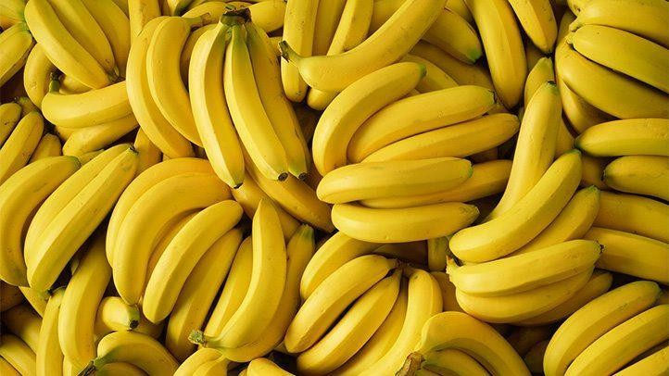
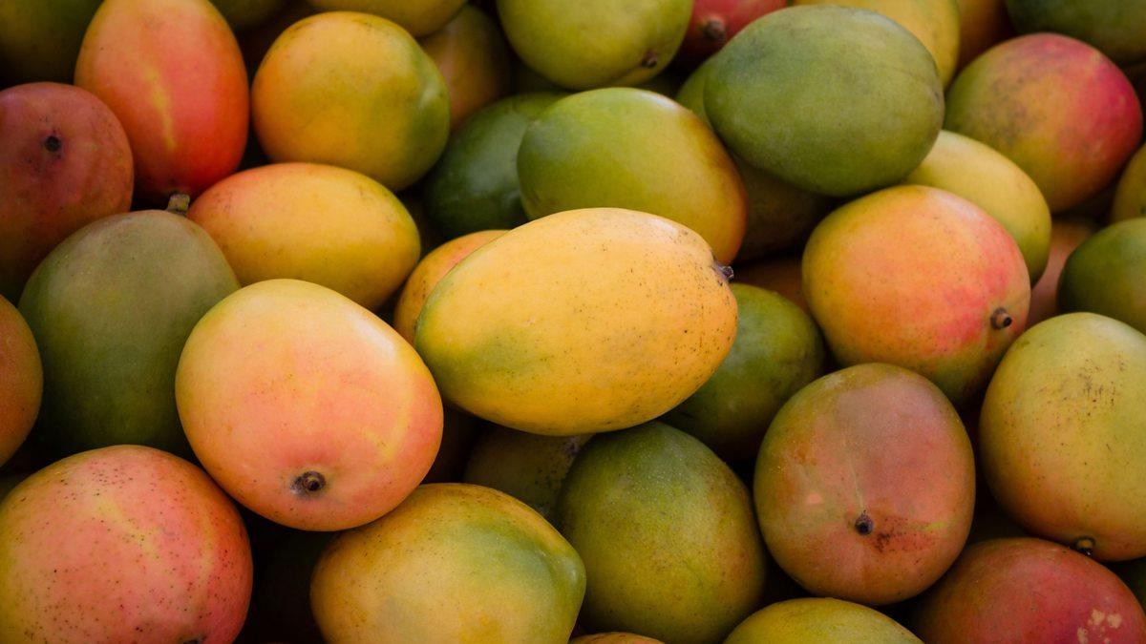
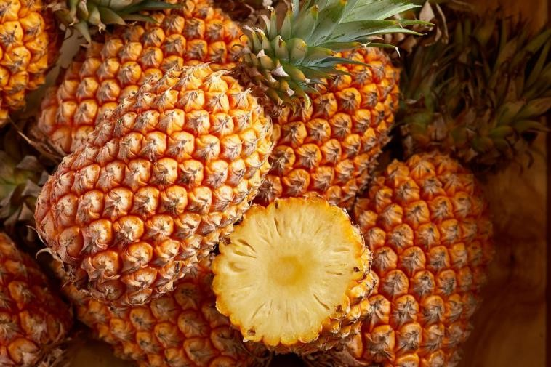
What is Pattern (cont.)
A set of instances that
share some regularities and similarities
is repeatable
is observable, sometimes partially, using sensors
may have noise and distortion

Slide 5
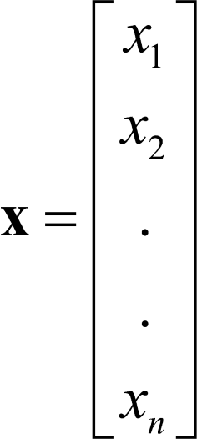
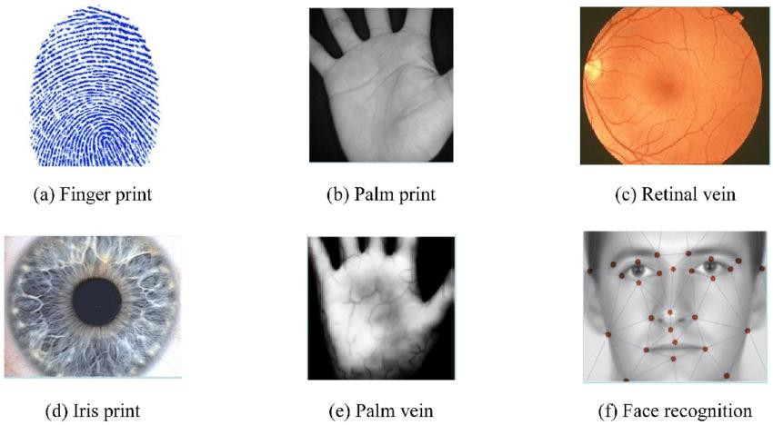
What is Pattern (cont.)
An object or event.
Represented by a vector x of values corresponding to various features
Some Biometric patterns

Slide 6
What is Class
A collection of “similar” objects
Class: Mangoes
Class: Bananas

Slide 7
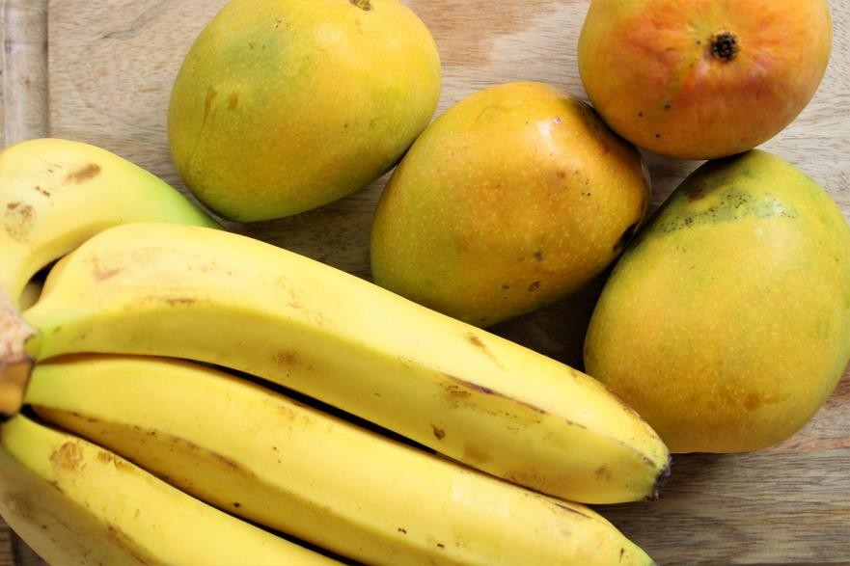
Main Objective
Separate data belonging to different classes.
Assign new data to the correct class.

Slide 8
What is Pattern Recognition
Pattern recognition(PR) is the scientific discipline that concerns the description and classification (recognition) of patterns (objects)
The task: Assign unknown objects –> patterns –> into the correct class. This is known as
classification.
Typical application areas
  Machine vision
  Character recognition (OCR)
  Computer aided diagnosis
  Speech recognition
  Face recognition
  Biometrics
  Image Data Base retrieval
  Data mining
  Bioinformatics

Slide 9
Representation of patterns
Features:
These are measurable quantities obtained from the patterns
The classification task is based on their respective values.
Feature vectors: A number of features
x₁ ,..., x_{l} ,
Constitute the feature vector
x = [x ,..., x ] ∈ R
T
l
1 l
Feature vectors are treated as random vectors.

Slide 10
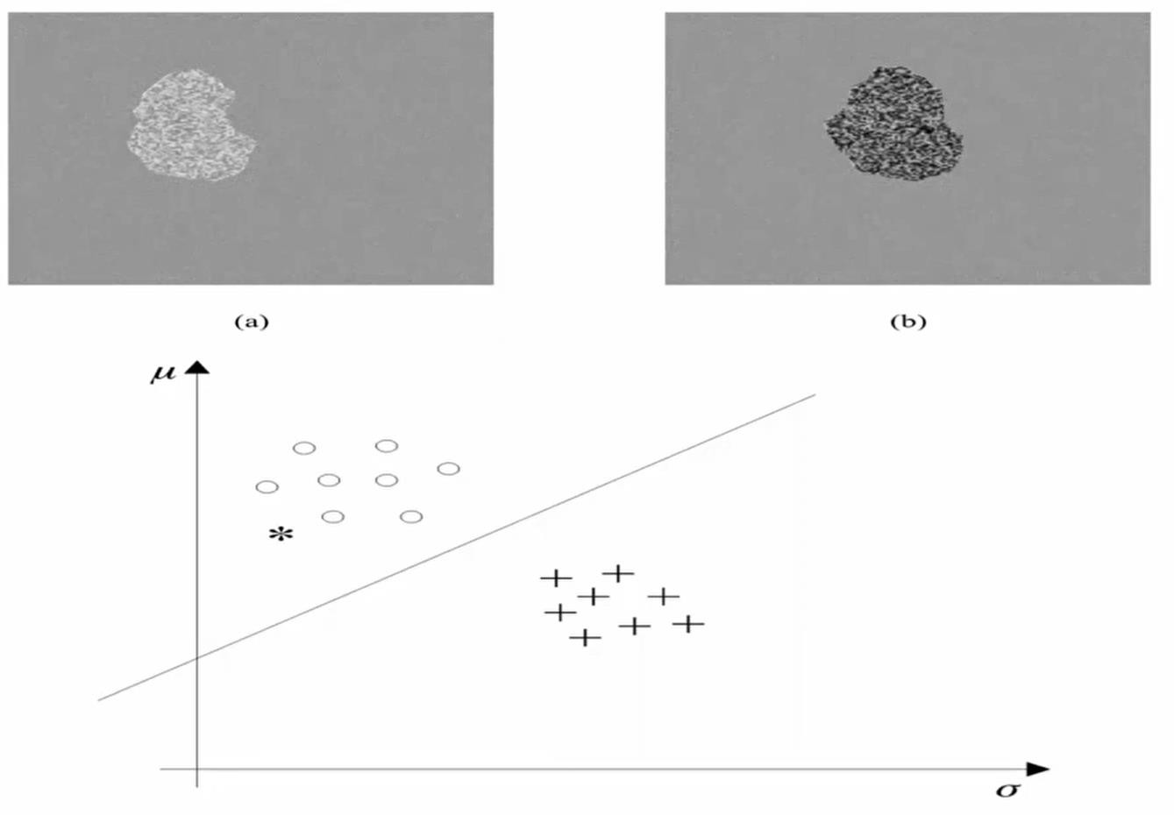
Example 01

Slide 11
Issues in Pattern Recognition
How are features generated?
What is the best numbers of features?
How are they used to design a classifier?
How good is the classifier?

Slide 12
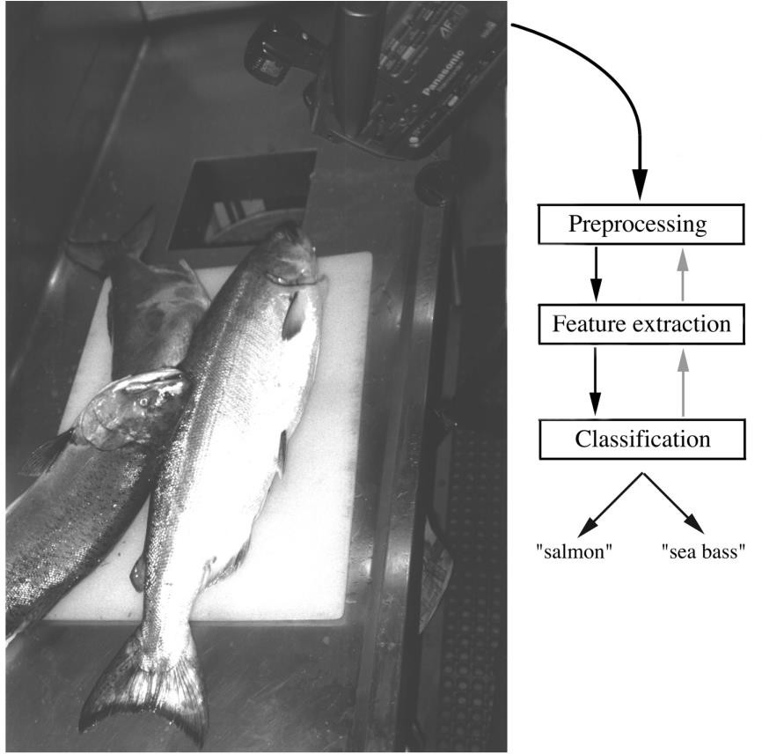
Example 02
“Sorting incoming Fish on a conveyor according to species using optical sensing”
Sea bass
Species
Salmon

Slide 13
Problem Analysis
Set up a camera and take some sample images to extract features
Length
Lightness
Width
Number and shape of fins
Position of the mouth etc.…
This is the set of all suggested features to explore for use
in our classifier!

Slide 14
Main Steps
Preprocessing:
Isolate fishes from one another and also removes background
Feature extraction:
Send isolated fish image to feature extractor
It reduces data too
Classification:
Pass the feature to a classifier

Slide 15
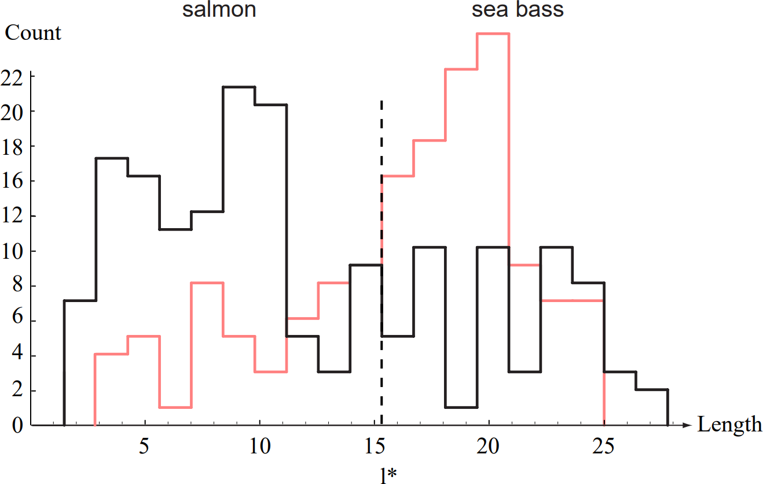
Length as a discriminator

Slide 16
Length as a discriminator
Conclusion: Length is a poor feature alone

Slide 17
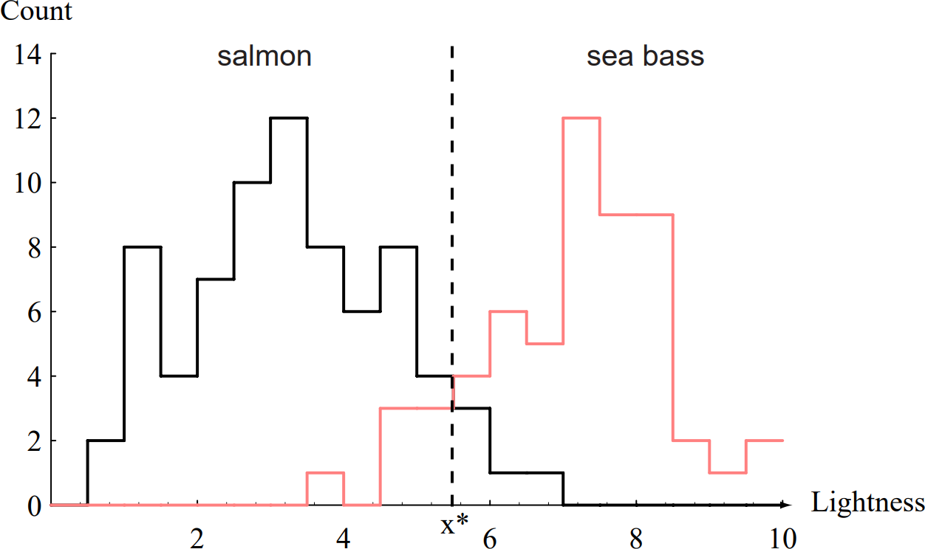
Lightness as a discriminator

Slide 18
Lightness as a discriminator
Lightness is a better feature than length because it reduces the misclassification error.
Can we combine features in such a way that we improve performance? (Hint: correlation)

Slide 19
Decision Boundary and Cost Relationship
Move our decision boundary toward smaller values of lightness in order to minimize the cost (reduce the number of sea bass that are classified salmon!)
Task of decision theory

Slide 20
Multiple features
To improve recognition accuracy, we might need to use more than one features.
Single features might not yield the best
performance.
Using combinations of features might yield better performance.
Adopt the lightness and add the width of the fish
Fish
x^{T} = [x₁, x₂]
Lightness
Width

Slide 21
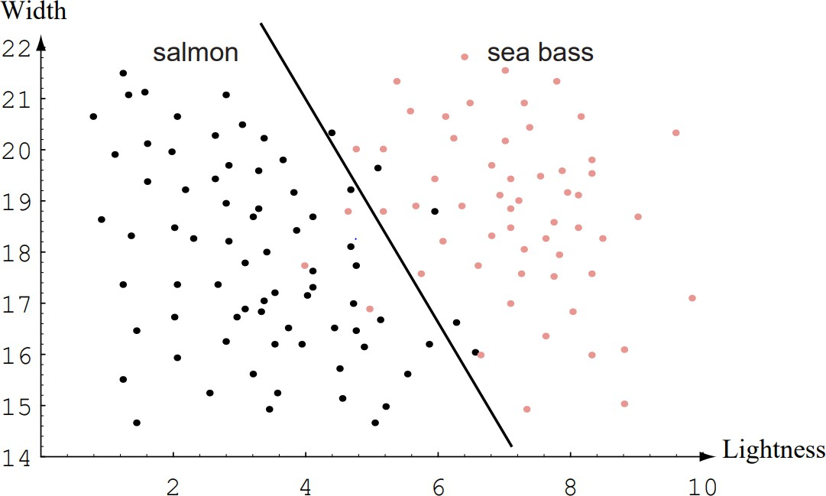
Multiple features
To improve recognition accuracy, we might need to use more than one features.
Single features might not yield the best
performance.
Using combinations of features might yield better performance.
Adopt the lightness and add the width of the fish
Fish
x^{T} = [x₁, x₂]
Lightness
Width

Slide 22
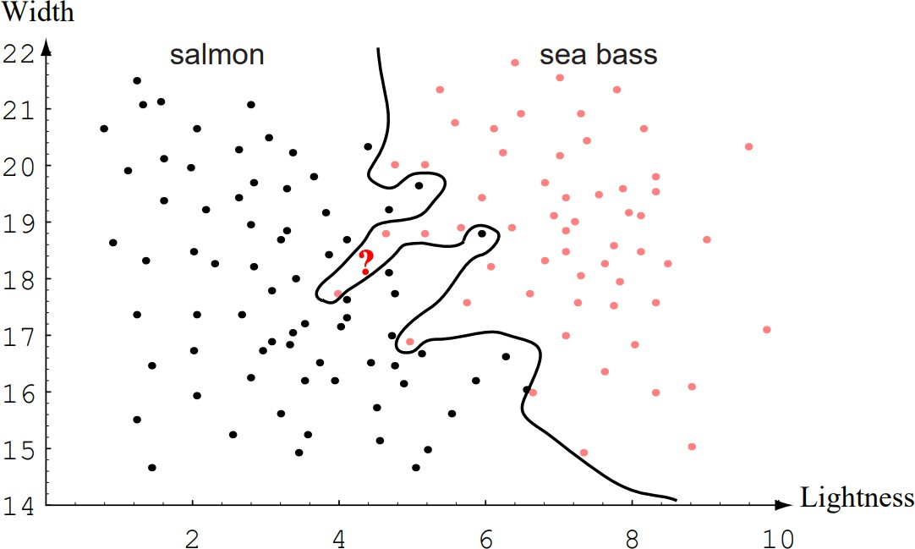
Complex decision boundary

Slide 23
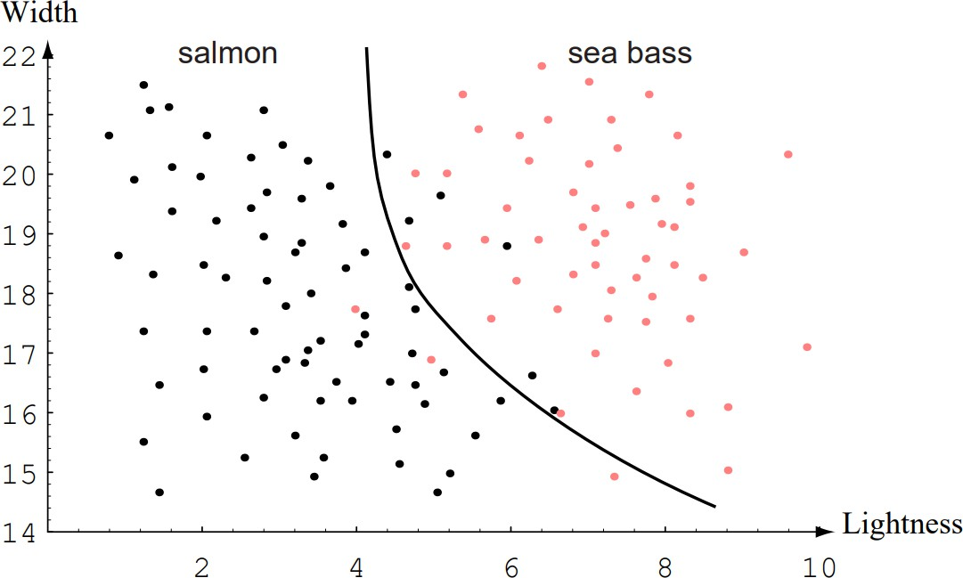
Compromise between training and testing

Slide 24
Complex model vs Simple model
Overfitting
Generalization

Slide 25
Complex model vs Simple model (cont.)
What is this?

Slide 26
Complex model vs Simple model (cont.)
What is this?
Underfitting

Slide 27
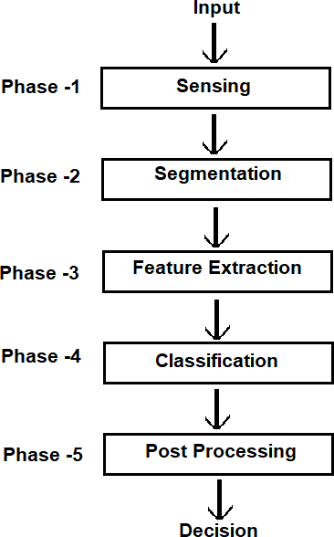
Design Cycle (Simplified)

Slide 28
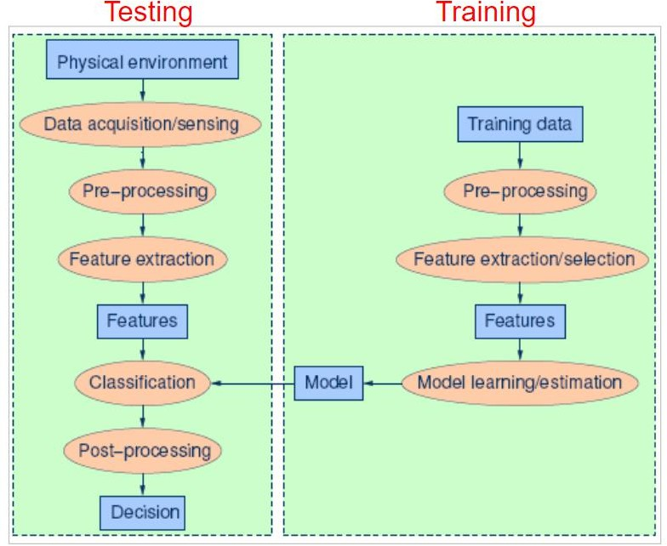
Design Cycle (Advanced)

Slide 29
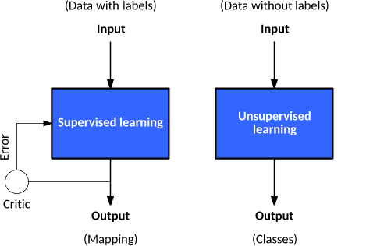
Learning
Reinforcement Learning
State
Environment
Agent
Action
Reward

Slide 30
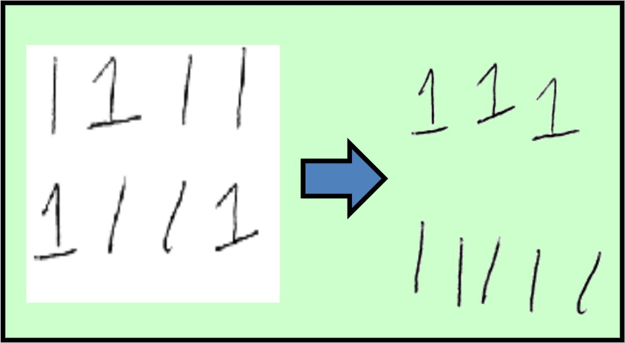
Supervised vs Unsupervised
Classification (known categories)
Clustering (unknown categories)

Slide 31
Supervised vs Unsupervised
Classification (known categories) Supervised
Clustering (unknown categories) Unsupervised

Slide 32
The End

